Slide 1

Practicals Aspects of Deep Learning
1 Train/dev/test sets
2 Bias/Variance
3 Basic “recipe” for machine learning
4 Regularization
5 Why regularization reduces overfitting
6 Dropout regularization
7 Understanding dropout
8 Other regularization methods
9 Normalizing inputs
10 Vanishing/exploding gradients
11 Numerical approximation of gradients
12 Gradient Checking
13 Gradient Checking implementation notes

Slide 2
Setting up your ML application
Train/dev/test sets

Slide 3
Applied ML is a highly iterative process
Deep learning is an iterative process and that making good choices in setting up your training, development, and test sets can make a huge difference in helping you quickly find a good high-performance neural network.
When training a neural network, you have to make a lot of decisions such as how many layers and hidden units your network should have, the learning rate, and activation functions. However, it is almost impossible to correctly guess the right values for all of these on your first attempt. Therefore, applied deep learning is an iterative process where you start with an idea and code it up to try it out, and based on the outcome, you refine your ideas and change your choices until you find a better neural network.

Slide 4

Applied ML is a highly iterative process
# layers
# hidden units learning rates activation functions
…
Idea
Experiment
Code

Slide 5
Applied ML is a highly iterative process
Deep learning has found great success in many areas, such as natural language processing, computer vision, speech recognition, and structured data, and the best choices may depend on various factors such as the amount of data you have, the number of input features, and your computer configuration.
The importance of setting up your data sets well, in terms of your train, development, and test sets, and gives some traditional ratios for splitting the data. However, in the modern big data era, it's also fine to set your dev and test sets to be much smaller than your 20% or even 10% of your data. It might be okay to not have a test set if you don't need an unbiased estimate of the performance of your algorithm.
Setting up a train dev and test set will allow you to integrate more quickly and efficiently measure the bias and variance of your algorithm so you can more efficiently select ways to improve it.

Slide 6
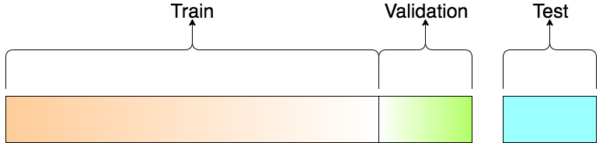
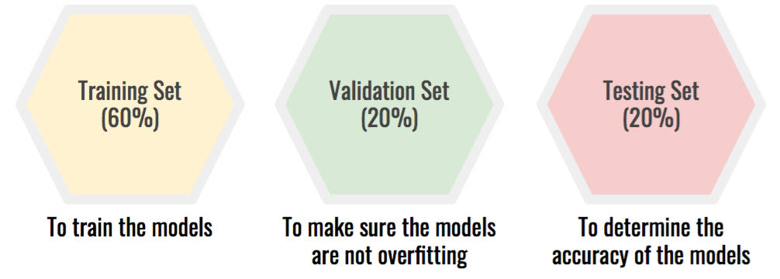
Train/dev/test sets

Slide 7
Mismatched train/test distribution
Training set:
Cat pictures from webpages
Dev/test sets:
Cat pictures from users using your app
Not having a test set might be okay. (Only dev set.)

Slide 8
Setting up your ML application
Bias/Variance

Slide 9
Bias/Variance
The concept of Bias and Variance is an important one in machine learning.
Bias refers to the difference between the expected predictions of a model and the true values of the data.
Variance refers to the amount by which the model's predictions vary for different training sets.
A good machine learning practitioner needs to have a sophisticated understanding of this concept because it is easily learned but difficult to master.

Slide 10
Bias/Variance
In deep learning, there is less discussion of the bias/variance trade-off because there is less of a trade-off in deep learning errors.
The bias/variance trade-off refers to the balance between underfitting and overfitting.
Underfitting occurs when the model is too simple and cannot capture the complexity of the data.
Overfitting occurs when the model is too complex and fits the training data too closely, resulting in poor performance on the test data. The sweet spot is somewhere in between, where the model is just right.

Slide 11
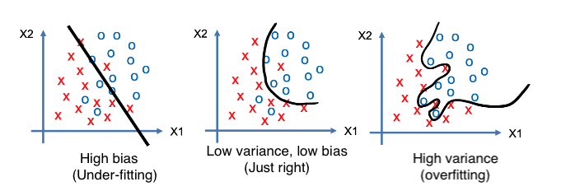
High bias and high variance

Slide 12
Bias/Variance
To diagnose whether a model has a bias or variance problem, the two key numbers to look at are the train set error and the dev set error:
If the training set error is low, but the dev set error is high, then the model may have high variance.
If the training set error is high and the dev set error is also high, then the model may have high bias.
If the training set error is high, but the dev set error is even higher, then the model may have both high bias and high variance.

Slide 13
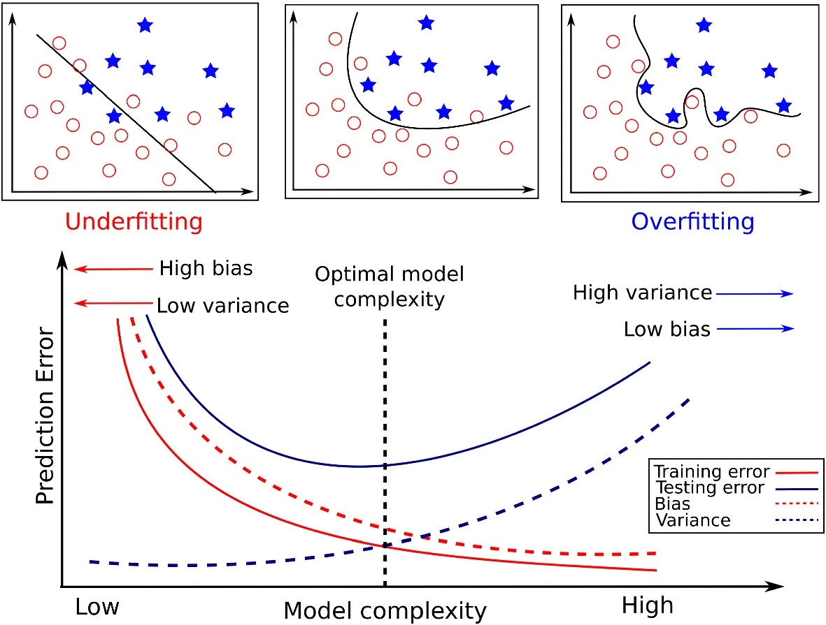
Bias and Variance

Slide 14
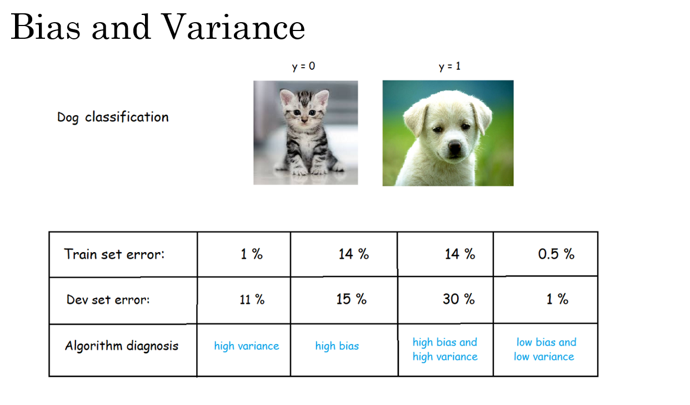

Slide 15
Bias/Variance
The assumption in this analysis is that the Bayes error is quite small, and that the training and dev sets are drawn from the same distribution. If these assumptions are violated, a more sophisticated analysis may be needed.
By understanding whether a model has high bias or high variance, a machine learning practitioner can try different techniques to improve the model's performance. In the next section, a basic recipe for machine learning will be presented to help improve the model's performance depending on whether it has high bias or high variance issues.

Slide 16
Setting up your ML application
Basic “recipe”
for machine
learning

Slide 17
Basic recipe for machine learning
A basic recipe for machine learning can improve the performance of an algorithm.
The first step is to diagnose whether the algorithm has a high bias problem, which means it is not even fitting the training set well.
- If this is the case, trying to pick a larger network with more hidden layers or hidden units, train for a longer time, or try a more advanced optimization algorithm.
- If none of these options work, the speaker suggests trying a different neural network architecture.
- The goal is to reduce bias to an acceptable amount.
Once bias is reduced, the second step is to diagnose whether the algorithm has a high variance problem, which means it is not generalizing well from the training set to the dev set. To reduce variance, the speaker suggests getting more data, using regularization, or trying a more appropriate neural network architecture. Again, the goal is to reduce variance to an acceptable amount.

Slide 18
Basic recipe for machine learning
The set of things to try depends on whether the algorithm has a high bias or high variance problem.
Note: in the modern deep learning era, getting a bigger network almost always reduces bias without necessarily hurting variance, so long as the network is regularized appropriately. The same is true for getting more data, which almost always reduces variance without hurting bias much.
Finally, regularization is a useful technique for reducing variance but can increase bias slightly.

Slide 19
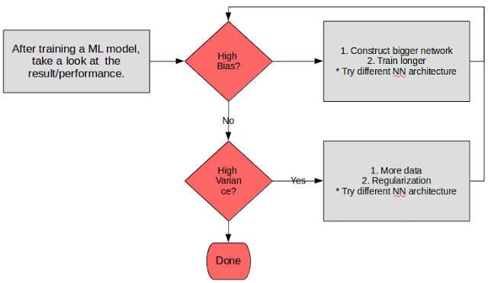
Basic recipe for machine learning

Slide 20
Regularizing your neural network
Regularization

Slide 21
Logistic Regression
Regularization helps prevent overfitting in a neural network by adding a penalty term to the cost function that encourages the weights to be small. This smallness of weights can help prevent the network from becoming too complex and overfitting the training data.
In other words, when a neural network has a large number of parameters, it can fit the training data very well, but it may not generalize well to new, unseen data. By adding a regularization term to the cost function, the neural network is encouraged to find weight values that are not only good at fitting the training data but also simple and smooth.
There are several types of regularization techniques, but they all work by adding a penalty term to the loss function, which the model tries to minimize during training. The penalty term discourages the model from learning too much from the training data and encourages it to find simpler solutions that generalize better to new data.

Slide 22
Logistic Regression
One common type of regularization is L2 regularization, also known as ridge regression, which adds a penalty term to the loss function proportional to the square of the magnitude of the model weights. This encourages the model to learn small weights and reduces the impact of any individual feature on the prediction.
Another type of regularization is L1 regularization, also known as Lasso regression, which adds a penalty term proportional to the absolute value of the model weights. This has the effect of shrinking some weights to zero, effectively performing feature selection and making the model more interpretable.

Slide 23
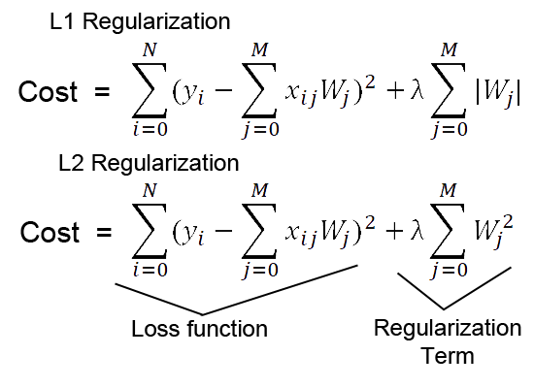
Logistic Regression

Slide 24
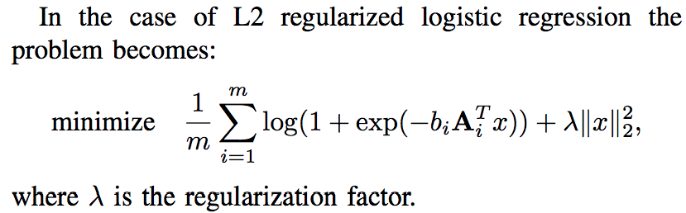
Logistic regression

Slide 25
Logistic Regression
Finally, there is dropout regularization, which randomly drops out some units in the neural network during training, preventing any single unit from becoming too important and reducing the risk of overfitting.
Overall, regularization is an important technique for improving the generalization performance of machine learning models, and it should be considered as a standard part of the modeling process.

Slide 26
Regularizing your neural network
Why regularization reduces overfitting

Slide 27
How does regularization prevent overfitting?
Regularization is a technique used in machine learning to prevent overfitting, which occurs when a model fits too closely to the training data and does not generalize well to new data. Overfitting can happen when a model is too complex and has too many parameters relative to the amount of training data available. Regularization helps to address this problem by adding a penalty term to the cost function that encourages the model to have smaller weights, which in turn makes the model less complex.
L2 regularization is one form of regularization that works by adding a penalty term to the cost function that is proportional to the square of the weights. This is also called the Frobenius norm. By adding this term, the model is incentivized to use smaller weights, which has the effect of reducing the complexity of the model and making it less prone to overfitting. As a result, L2 regularization can help with reducing variance problems.

Slide 28
How does regularization prevent overfitting?
One way to understand how L2 regularization helps with overfitting is by considering the impact of a large regularization parameter. When the regularization parameter is set to be very large, the weight matrices are encouraged to be close to zero, which can effectively zero out the impact of many hidden units. This has the effect of reducing the size of the neural network and making it less complex. However, in practice, each hidden unit still has some impact, but it is reduced. This results in a simpler network that is less prone to overfitting.
Another way to understand how L2 regularization helps with overfitting is by considering the impact of the activation function used in the neural network. If the regularization parameter is set to be large, the weights are encouraged to be small, which can cause the activation function to behave in a more linear manner. This can result in a neural network that behaves like a linear model, which is simpler and less prone to overfitting.

Slide 29
How does regularization prevent overfitting?
When implementing L2 regularization, it is important to remember to modify the cost function by adding the penalty term. This can impact the behavior of gradient descent, so it is important to monitor the cost function to ensure that it decreases monotonically after each iteration.
In summary, L2 regularization can help with overfitting by reducing the complexity of a model through the use of smaller weights. This makes the model less prone to overfitting and can help with reducing variance problems.
Another type of regularization is L1 regularization, also known as Lasso regression, which adds a penalty term proportional to the absolute value of the model weights. This has the effect of shrinking some weights to zero, effectively performing feature selection and making the model more interpretable.

Slide 30
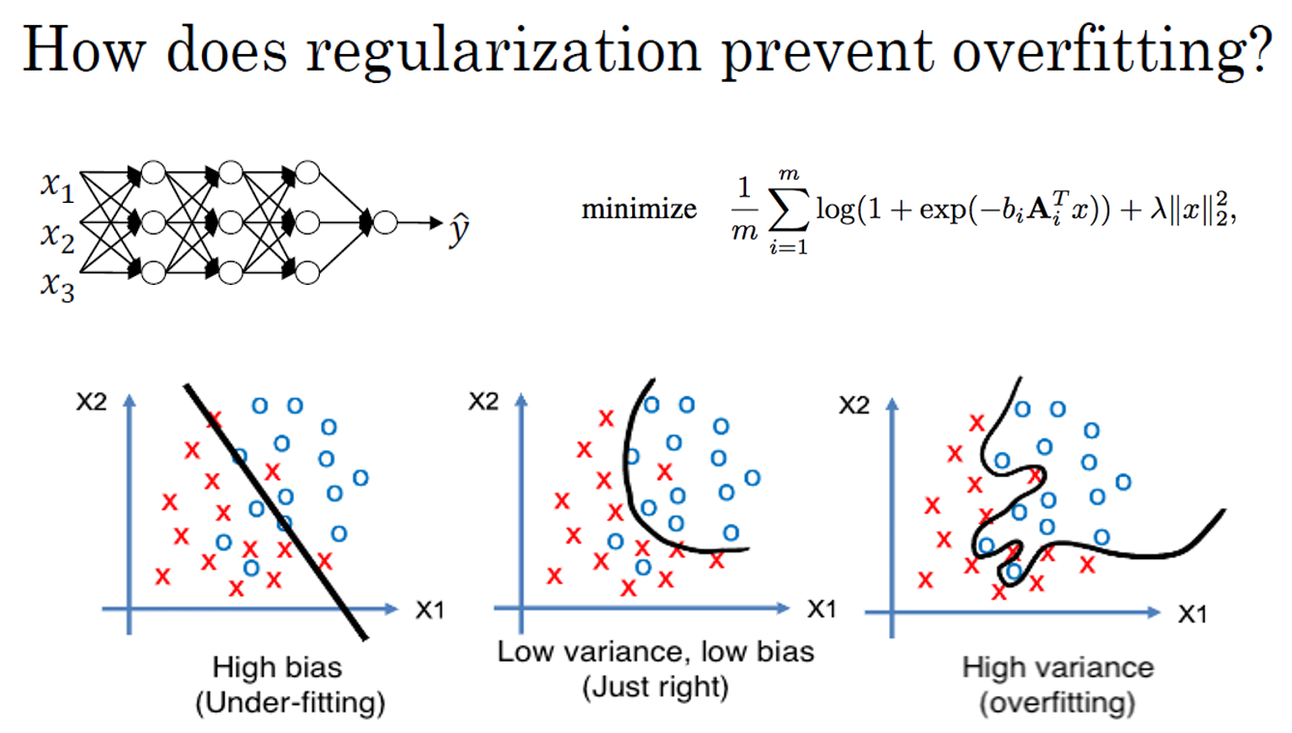

Slide 31
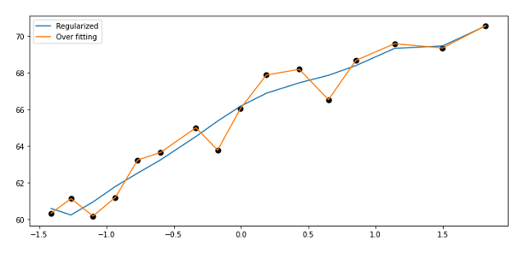
How does regularization prevent overfitting?

Slide 32
Regularizing your neural network
Dropout regularization

Slide 33
Dropout regularization
Dropout is a powerful regularization technique that can help prevent overfitting in neural networks. The basic idea of dropout is to randomly eliminate, or "drop out," some nodes in the neural network during training. This means that the network is effectively training on a smaller, more reduced version of itself.
To implement dropout, we first set a probability for each node in each layer of the network. For example, we might set a probability of 0.5 for each node in each layer. Then, for each training example, we toss a coin for each node to determine whether or not to keep it. If the coin lands on heads, we keep the node. If the coin lands on tails, we eliminate the node and all its outgoing connections. We then train the neural network using this reduced version of itself.

Slide 34
Dropout regularization
We implement dropout using a technique called "inverted dropout," which involves scaling up the activations of the remaining nodes by a factor of 1/keep.prob, where keep.prob is the probability of keeping each node. This ensures that the expected value of the activations remains the same.
At test time, we don't use dropout explicitly, since we don't want our predictions to be random. Instead, we use the full, un-dropped-out neural network to make predictions.
The reason dropout works is because it helps prevent overfitting by reducing the co-adaptation between neurons. When we drop out some nodes during training, the remaining nodes must learn to perform the task on their own, rather than relying on co-adaptation with other nodes. This can lead to more robust generalization performance on new data.

Slide 35
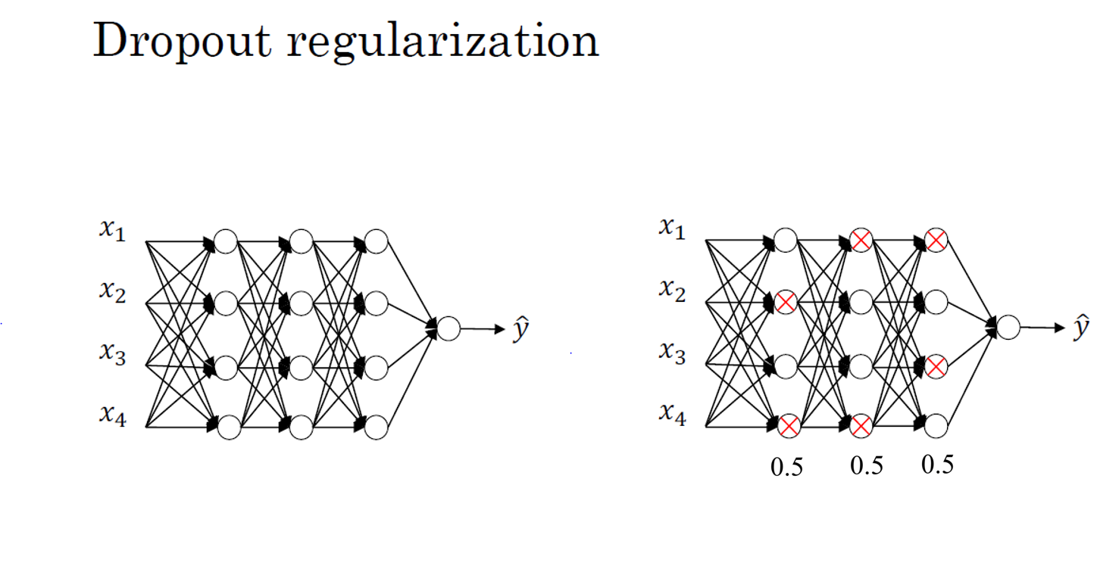

Slide 36
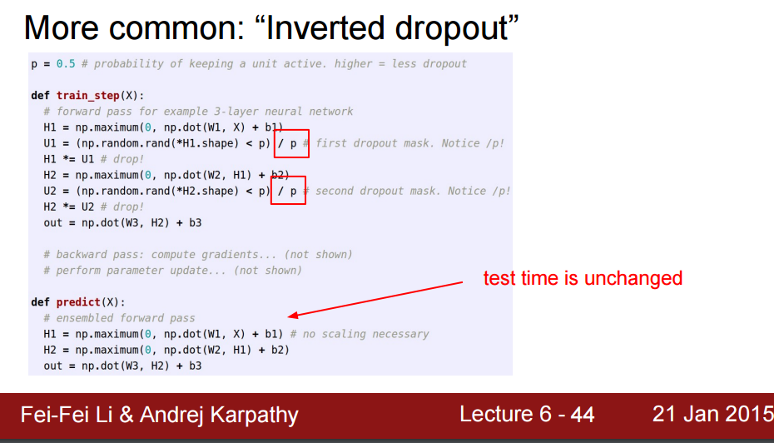
Implementing dropout (“Inverted dropout”)

Slide 37
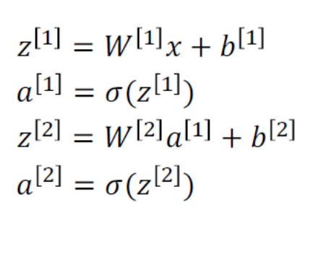
Making predictions at test time
No drop-out

Slide 38
Regularizing your neural network
Understanding dropout

Slide 39
Why does drop-out work?
One intuition for why dropout works is that it forces the network to spread out its weights and not rely too heavily on any one input or feature. When a unit's inputs can get randomly eliminated, it can't rely on any one feature because it could go away at random. As a result, the unit will be more motivated to spread out its weights and give a little bit of weight to each of its inputs. By spreading out the weights, this tends to have an effect of shrinking the squared norm of the weights, similar to what we saw with L2 regularization.
In practice, we choose a "keep prop" parameter, which is the chance of keeping a unit in each layer. We can vary the keep prop by layer, with lower values for layers where we are more worried about overfitting.

Slide 40
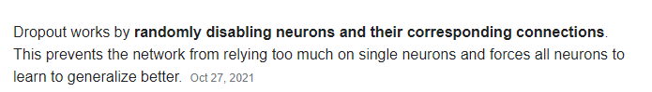
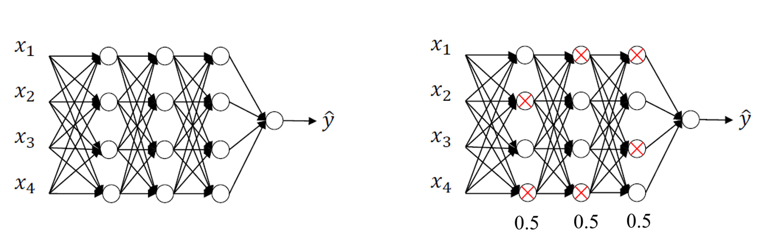
Why does drop-out work?
Intuition: Can’t rely on any one feature, so have to spread out weights.

Slide 41
Why does drop-out work?
One downside of dropout is that it makes the cost function J less well defined on every iteration, as we are randomly knocking out units. This makes it harder to double check the performance of the network, and we may need to turn off dropout to check that our code is working properly.
While dropout is frequently used in computer vision, it may be less useful in other application areas where overfitting is less of an issue. There are also other regularization techniques, which we will discuss in the next slides.

Slide 42
Regularizing your neural network
Other regularization methods

Slide 43











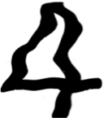


Other regularization methods
One technique is data augmentation, which involves creating additional training examples by distorting existing ones, such as flipping images horizontally or taking random crops of an image. By doing this, the algorithm is trained on a more diverse set of examples, which can help it generalize better.
4

Slide 44
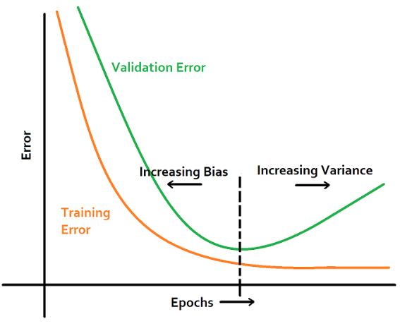
Other regularization methods
Another technique is early stopping, which involves stopping the training process before it reaches the point of overfitting. This is done by monitoring the performance of the model on a validation set during training and stopping when the validation error starts to increase. By doing this, the model is prevented from continuing to fit the noise in the training data and is forced to generalize better.

Slide 45
Other regularization methods
However, early stopping can couple the optimization and regularization tasks, making it more complicated to search for hyperparameters. The author suggests using L2 regularization instead and trying different values of the regularization parameter lambda, which can make the search space of hyperparameters easier to decompose and search over.
The concept of orthogonalization involves separating the tasks of optimizing the cost function and reducing overfitting. By doing this, it becomes easier to search for hyperparameters and optimize the model efficiently.

Slide 46
Setting up your optimization problem
Normalizing inputs

Slide 47
Normalizing training sets
Normalizing input features means scaling the features so that they are on similar scales. This is done to make the cost function of the neural network more symmetric, which makes it easier and faster to optimize. The normalization process involves two steps:
- The first step is to subtract the mean from each feature, so that the features have zero mean.
- The second step is to divide each feature by its standard deviation, so that the features have unit variance.
Normalizing input features is important when the input features come from very different scales, as this can make it difficult for the optimization algorithm to converge. If the features are on similar scales, normalization is less important, but it is still a good practice to perform.

Slide 48
Normalizing training sets
Note that the following right diagram feature x_1 has very much larger variance than feature x_2 here. After variance normalization, the variance of x_1 and x_2 are both equal to 1.

Slide 49
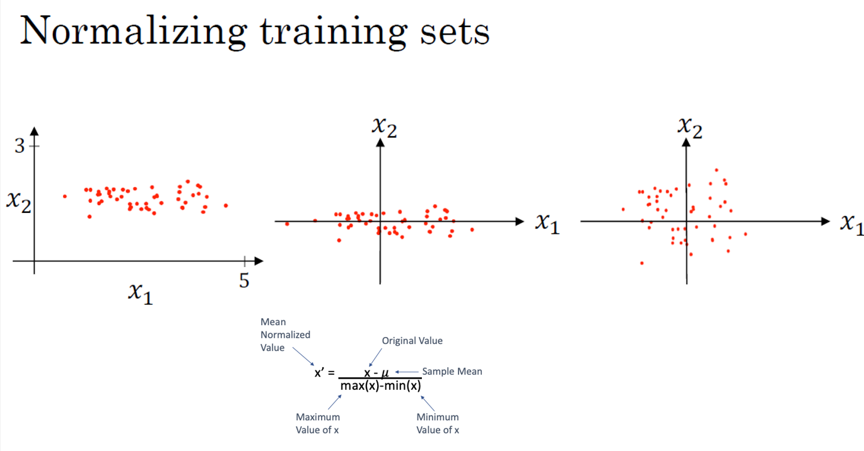
Subtract mean:

Slide 50
Normalizing training sets
It is also important to use the same normalization parameters (mean and standard deviation) for both the training and test sets, so that the test set is scaled in the same way as the training set. This ensures that the test set is evaluated on the same features that the neural network was trained on.

Slide 51
Why normalize input?
Another thing is when you training a deep network the gradient may be very big or very small and this makes training difficult, namely the problem of vanishing or exploding gradient. You can carefully choose the random weight initialization hopefully that your weight will not explode so quickly or decay to zero quickly, so, you can train a reasonable deep network without your weight exploding or vanishing so much.
For the sake of simplicity, here we have an example deep network with each neuron having the linear function as the activation function, and set b^[i] being zero. If we initialize W^[i] a little bigger than the identity matrix, then with very deep networks the activation can explode, and if W^[i] is just a little bit less than the identity, then the activation will decrease exponentially.

Slide 52
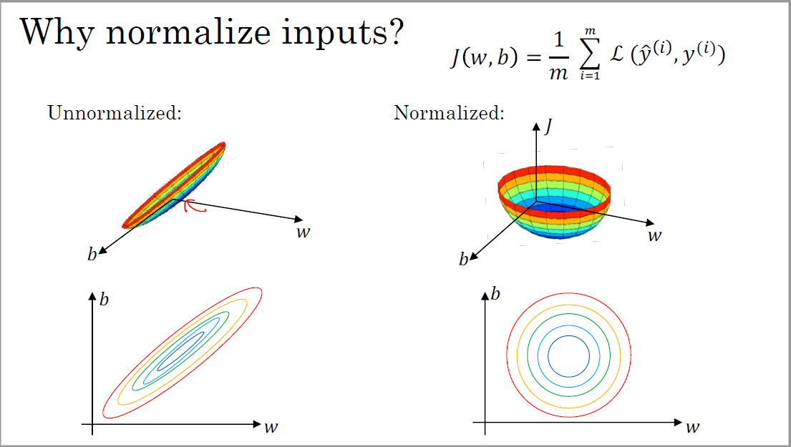

Slide 53
Setting up your optimization problem
Vanishing/exploding gradients

Slide 54
Vanishing/exploding gradients
In neural network training, the problem of vanishing and exploding gradients can occur, especially in very deep neural networks. This problem arises when the derivatives or slopes become very large or very small, which makes training difficult. The video explains this problem using an example of a deep neural network with linear activation function and careful choices of random weight initialization to reduce the problem.
If each weight matrix in a deep network is slightly larger than the identity matrix, then the output can explode exponentially, while if each matrix is slightly smaller than the identity matrix, then the activations can decrease exponentially. Similarly, the derivatives or gradients can increase or decrease exponentially with the number of layers in a deep network. This problem makes training difficult, especially if the gradients become exponentially small, as gradient descent will take tiny steps and take a long time to learn anything.

Slide 55
Vanishing/exploding gradients
One solution to this problem is to carefully initialize the weights to reduce the impact of vanishing or exploding gradients. This can help reduce the problem, but it does not completely solve it.

Slide 56
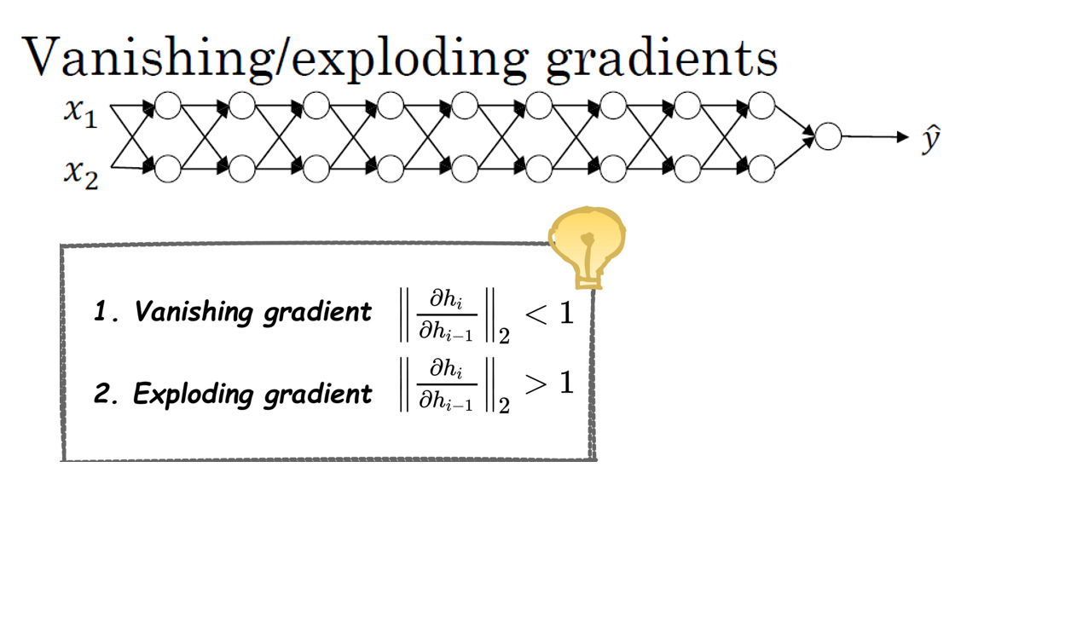

Slide 57
Setting up your optimization problem
Weight Initialization for Deep Networks

Slide 58
Single neuron example
The idea is to set the variance of the weight matrix to be 1/n, where n is the number of input features going into the neuron. This helps to ensure that the sum of the weights multiplied by the inputs does not become too large or too small. For ReLU activation function, it turns out that setting the variance to 2/n works better.
For a deep neural network, the weight initialization is generalized by setting the weight matrix to be np.random.randn times the square root of 2/n(l-1), where n(l-1) is the number of units feeding into each unit in layer l. This initialization helps to reduce the vanishing and exploding gradients problem by setting each weight matrix to be close to 1.

Slide 59
Single neuron example
Other variants of weight initialization for different activation functions:
- The TanH activation function. The Xavier initialization is used for TanH activation function, and it involves setting the variance to be 1/n instead of 2/n.
- Another version, taught by Yoshua Bengio and colleagues, uses a different formula that has some theoretical justification.
In practice, all these formulas give a starting point for the variance of the weight initialization, which can be tuned with hyperparameters. Tuning this parameter can help reduce the vanishing and exploding gradients problem, but it is usually lower down in importance relative to other hyperparameters.
Overall, careful choice of weight initialization can help make neural networks train much more quickly, and avoid the problem of vanishing or exploding gradients.

Slide 60
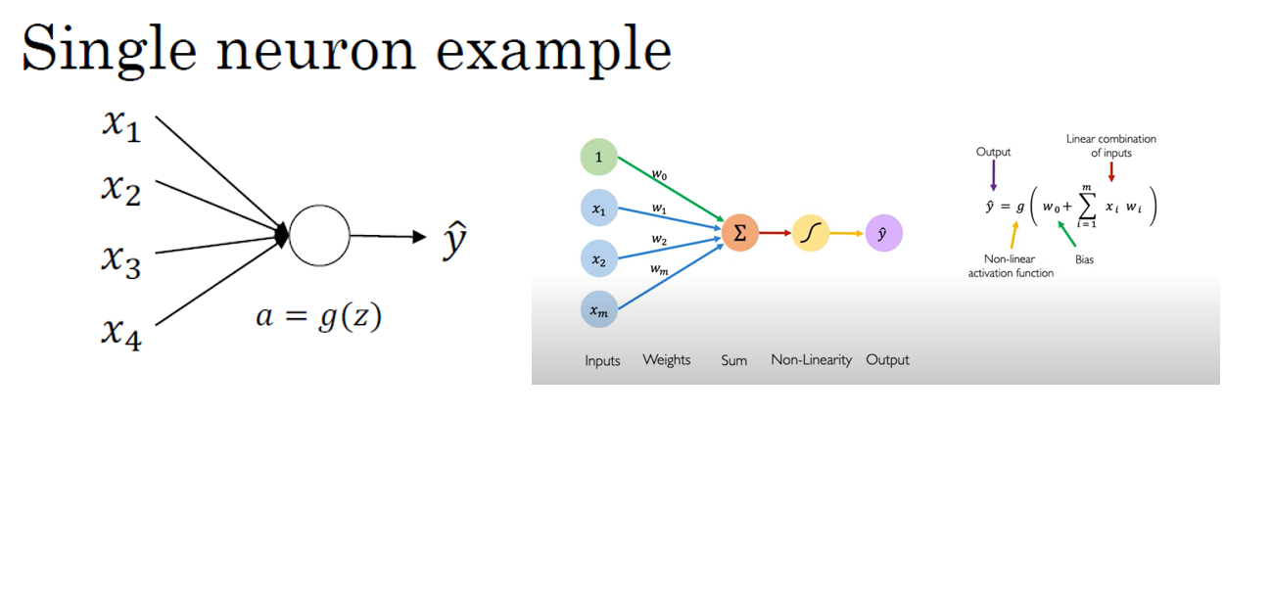

Slide 61
Setting up your optimization problem
Numerical approximation of gradients

Slide 62
Checking your derivative computation
Backpropagation is a commonly used algorithm in neural networks to calculate the gradient of the loss function with respect to the network parameters. It is used to train the network by adjusting the weights and biases to minimize the loss. However, implementing backpropagation can be complex and there may be errors in the implementation. To ensure that the implementation is correct, gradient checking can be used.
Gradient checking is a numerical method used to verify whether the gradient of a function is calculated correctly. It works by approximating the derivative using a two-sided difference formula. Instead of just nudging the parameter to the right to get theta plus epsilon, the parameter is nudged to the right and left to get theta minus epsilon and theta plus epsilon, respectively. Then, the height over the width of a larger triangle is computed to get a better estimate of the derivative.

Slide 63
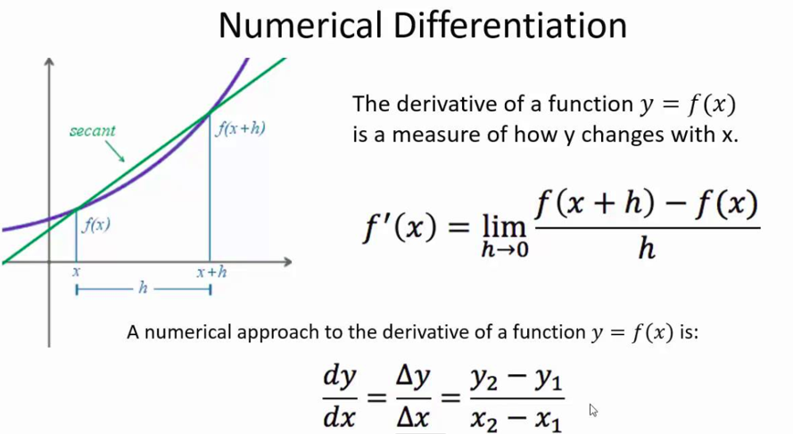
Checking your derivative computation

Slide 64
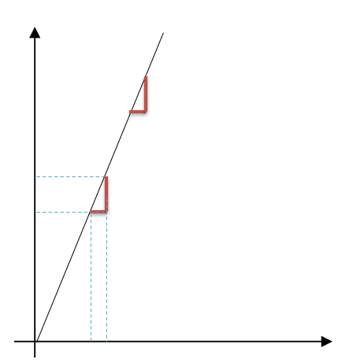
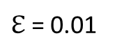
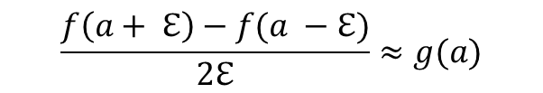
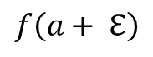

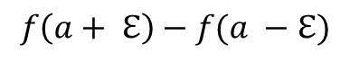
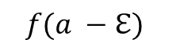

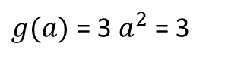

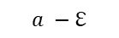

Checking your derivative computation

Slide 65
Checking your derivative computation
To use gradient checking, the function g that someone else gives you is compared to the true gradient of the function f using the two-sided difference formula. If the two are very close, it can be concluded that the implementation of backpropagation is correct. If not, there may be a bug in the implementation that needs to be fixed.
It is worth noting that the two-sided difference formula is more accurate but runs twice as slow as the one-sided difference formula. However, it is still preferred for gradient checking because it gives more accurate results.

Slide 66
Setting up your optimization problem
Gradient Checking

Slide 67
Gradient check for a neuron network
Gradient checking is a technique used to verify the correctness of the implementation of backpropagation in neural networks. To implement gradient checking, all the parameters of the network, such as W1, B1, W2, B2, etc., are reshaped into a giant parameter vector, theta. The cost function J, which is a function of all the parameters, is also expressed as a function of theta.
A loop is implemented to compute d theta approx for each component of theta using a two-sided difference formula. Then, two vectors, d theta approx and d theta, are obtained, which should be approximately equal to each other. The difference between these vectors is computed using the Euclidean distance, which should be a very small value. If it's not, then there may be a bug in the implementation that needs to be fixed.

Slide 68
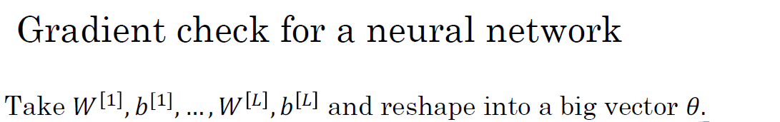

Slide 69
Gradient check for a neuron network
To implement gradient checking, epsilon is typically set to 10^-7. If the formula gives a value much smaller than 10^-7, it means that the derivative approximation is correct. If the value is in the range of 10^-5, then it may be okay, but the components of the vector should be carefully checked. If the value is much larger than 10^-3, then there may be a bug somewhere.
Gradient checking has helped many people find bugs in their implementations of backpropagation. It can save a lot of time and improve the confidence in the implementation's correctness.

Slide 70
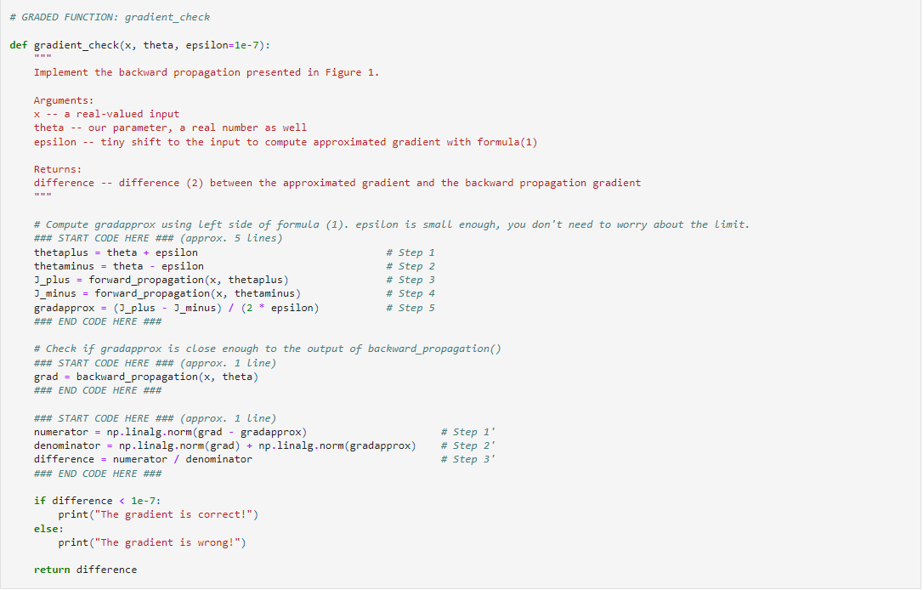
Gradient checking (Grad check)

Slide 71
Setting up your optimization problem
Gradient Checking implementation notes

Slide 72
Gradient checking implementation notes
Don’t use in training – only to debug
If algorithm fails grad check, look at components to try to identify bug.
Remember regularization.
Doesn’t work with dropout.
Run at random initialization; perhaps again after some training.

